Slide 1

Quality Improvement Planning Workbook
© 2021 Australian Children’s Education and Care Quality Authority Copyright in this workbook and any materials included in the Quality Improvement Program is owned by ACECQA. The workbook and related materials cannot be modified or adapted without written permission from ACECQA.

Slide 2



Acronyms
ACECQA Australian Children’s Education and Care Quality Authority
EYLF Being, Belonging & Becoming: The Early Years Learning Framework
MTOP My Time, Our Place – Framework for School Age Care
NQF National Quality Framework
NQS National Quality Standard
QIP Quality Improvement Plan
How to use this workbook
In this workbook you will find activities and information about quality improvement processes that improve outcomes for children. You can use this workbook with or without the modules. You can use it individually and with your service team.
When you see this image – pause the module and make notes in your workbook.
When you see this image – pause the module and do the activity individually or with your team.
When you see this image – you’ll find tips for implementing quality improvement processes at your service.

Slide 3

Notes
Reflections of learning

Slide 4
Module 1 – Self-assessment

Slide 5
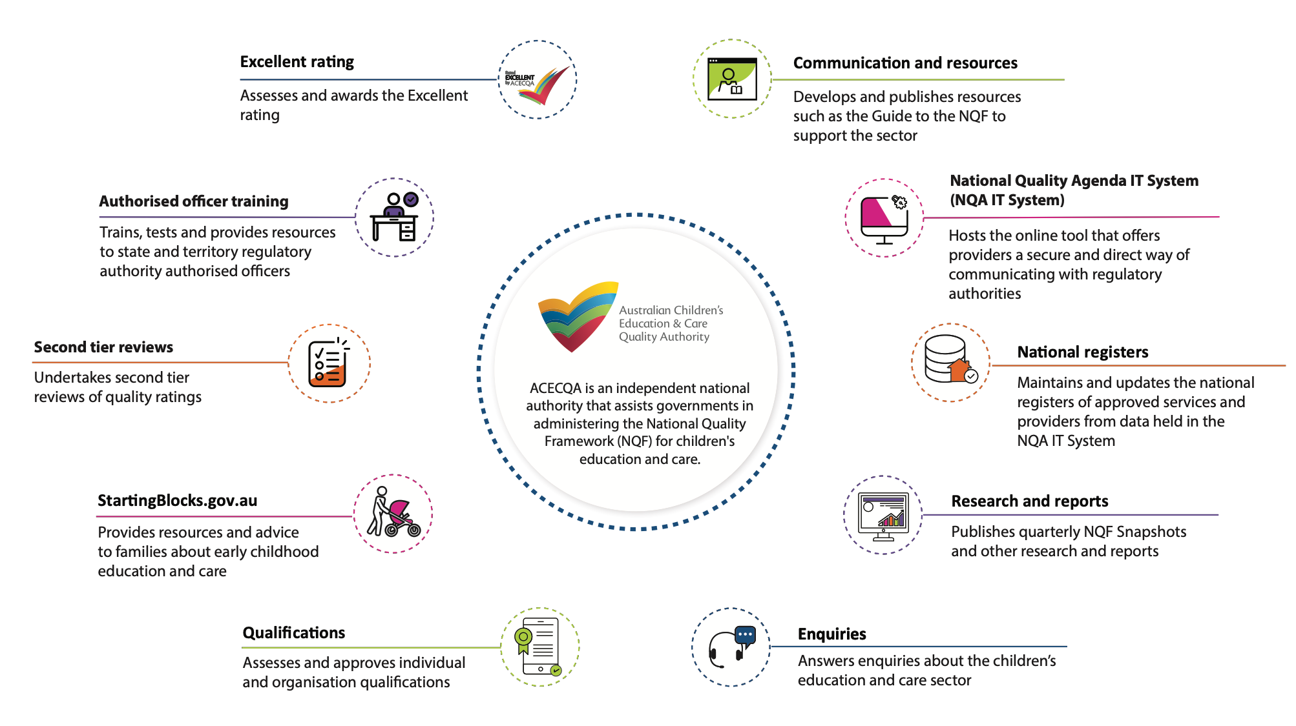
ACECQA

Slide 6
Activity 1
Write down what do you already know about the
National Quality Standard (NQS)?

Slide 7
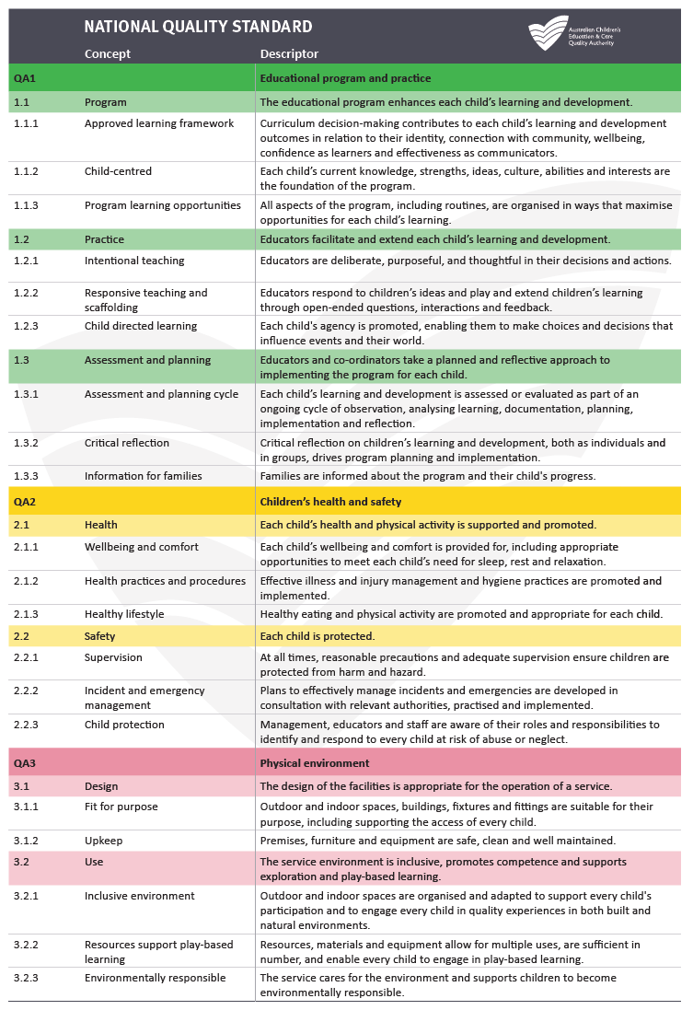
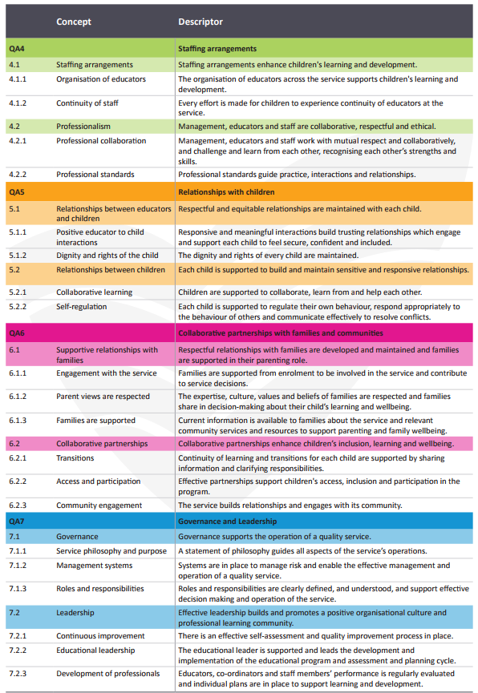

Slide 8

Activity 2
The National Quality Standard
In your own words write down what each quality area means to you.
Quality Area 1:
Quality Area 2:
Quality Area 3:
Quality Area 4:
Quality Area 5:
Quality Area 6:
Quality Area 7:

Slide 9
The Quality Improvement Process
1. SERVICE PHILOSOPHY
2. SELF-ASSESS
3. IDENTIFY STRENGTHS & AREAS FOR IMPROVEMENT
4. QUALITY IMPROVEMENT PLANNING
5. REVIEW AND REFLECT
QIP
CYCLE
(Self-assessment Tool, p. 18)
9

Slide 10
Activity 3
Why are quality improvement planning processes important to children?
10

Slide 11
What is self-assessment?
What does it involve?
Self-assessment is the first step in quality improvement and is an important part of providing quality outcomes for children and families.
Self-assessment involves:
critically reflecting and evaluating your service practices
recognising your strengths and identifying opportunities for improvement
providing an honest and informed picture of your unique service context, and
describing the quality of education and care experienced by children and families attending your service.
The self-assessment process is the starting point for determining and planning quality improvements in your service. It helps to inform quality improvement planning and will inform the development of your QIP.
It also helps develop clear links between your service’s self-assessment documentation and identified priorities for attention in your QIP.
In self-assessment you will evaluate your service practices against:
the requirements of the National Law and National Regulations
the NQS
the approved learning frameworks.
After this evaluation you will identify goals for improvements that enhance the quality of children's and families' experiences at your service.
These goals for improvements are incorporated into your service's QIP.
Your self-assessment will provide an informed picture of:
your current practice
the quality of education and care experienced by children and families at your service
your service’s strengths and
Documenting the self-assessment process will demonstrate that your service has completed it and show how the process has informed your QIP.
11

Slide 12
Tips for self-assessment process
1. SERVICE PHILOSOPHY
2. SELF-ASSESS
3. IDENTIFY STRENGTHS & AREAS FOR IMPROVEMENT
4. QUALITY IMPROVEMENT PLANNING
5. REVIEW AND REFLECT
1. Start by reflecting on your service philosophy. Does it reflect your service’s operations, is everyone familiar with the philosophy and its purpose.
5. Review and reflect on your self-assessment processes
2. Self-assess ‘what you do’ against:
National Law and National Regulations
the NQS quality areas.
4. Use the outcomes of your
self-assessment to inform the development and to update you QIP.
3. Analyse the self-assessment to identify:
strengths-what you are doing well
areas for improvement
(Self-assessment Tool, p. 18)
12

Slide 13
Tips for self-assessment
Keep self-assessment active and ongoing
Staff meetings are an ideal opportunity to undertake critical reflection and self-assessment as a team.
You could identify a particular aspect of practice to discuss before the meeting, so that everyone has the chance to think about it beforehand. This will also empower staff to be involved in the self-assessment process.
Have an organised approach to continuous self-assessment which will help your service team stay focused on quality improvement.
Using an organised approach means:
having a plan to regularly review all aspects of the NQS
keeping a record of what has been assessed and when that occurred
sharing the responsibility amongst the team.
13

Slide 14
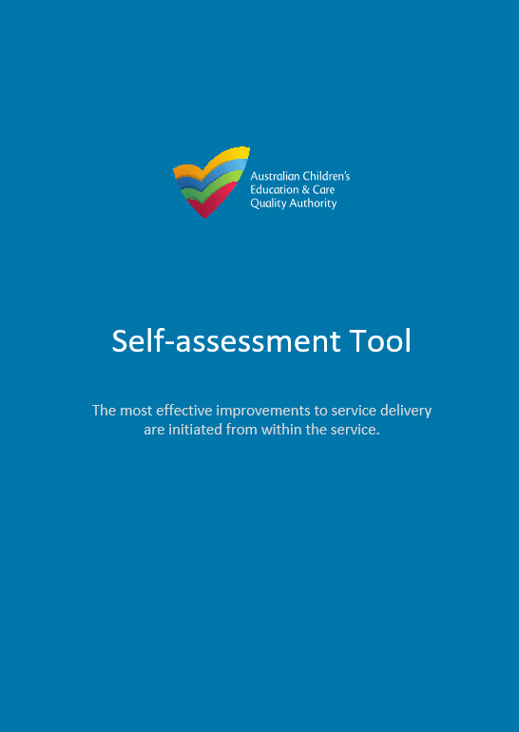
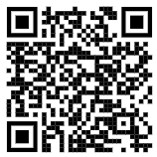
ACECQA’s Self-assessment Tool
ACECQA’s Self-assessment Tool supports education and care services to assess the quality of their practices, policies and procedures, against the NQS and the National Law and Regulations.
Suitable for all for all service types, the tool supports service teams to:
assess current practice
identify service strengths and identify areas for improvement
critically reflect on how practice achieves quality outcomes for children and families
share service practice with families, the community and authorised officers.
ACECQA’s Self-assessment Tool provides a step by step guide to support services in undertaking an effective self-assessment process.
The Self-assessment Tool also contains information on:
the aim and intent of the tool
tips for planning and engaging in self-assessment
why to self-assess and who is involved in self-assessment
critical reflection in self-assessment
identifying service practice that is beyond ‘Meeting the NQS’
self-assessment as a continuous process
resources to support your self-assessment.
The tool is available as a free download on the ACECQA website.
14

Slide 15
ACECQA’s Self-assessment Tool
ACECQA’s Self-assessment Tool provides a series of reflective questions to help you document your practices. Use these with your service team as you consider each quality area of the NQS.
  What practices do we implement that demonstrates this standard?
How are our practices improving outcomes for children and families?
How do we demonstrate that our practice is typical for our service?
How do/could we articulate what informs our practice?
How do we engage with families and or the community?
What are the areas where we need to take immediate action?
What are the opportunities for quality improvement?
15

Slide 16




Activity 4
Who can be part of quality improvement?
Families and carers
Service location and environment
Service providers and leaders
Traditional Custodians
16

Slide 17




Activity 4
Who can be part of quality improvement?
The children
Local schools and other services
Your local community
Who else could be involved?
17

Slide 18
Activity 5
Reflective questions for self-assessment
How does your service undertake self-assessment?
What is being done well at your service?
How did you identify areas where quality improvements could be made?
18

Slide 19
Module 2 – Quality Improvement Plan
19

Slide 20
What is a Quality Improvement Plan (QIP)?
The aim of a QIP is to help providers self-assess their performance in delivering quality education and care, and to plan future improvements.
A QIP must:
include an assessment of the programs and practices at the service against the NQS and National Regulations
identify areas for improvement
include a statement about the service’s philosophy.
A QIP will also showcase and celebrate your service's strengths.
20

Slide 21
Activity 1
Reflect on your service QIP
List four things you know about your service QIP.
How are you involved in developing the QIP?
Write down two improvements you think are important at your service.
21

Slide 22
The Legislative QIP Requirements
The National Legislation states that a QIP must:
include a statement about the service’s philosophy
include an assessment of the programs and practices at the service against the NQS and National Regulations
identify areas for improvement
be prepared for a new service within 3 months of the service approval being granted and provided to the regulatory authority upon request
be updated at least once a year
be available on request by the regulatory authority or families of a child enrolled or looking to enrol at the service.
22

Slide 23
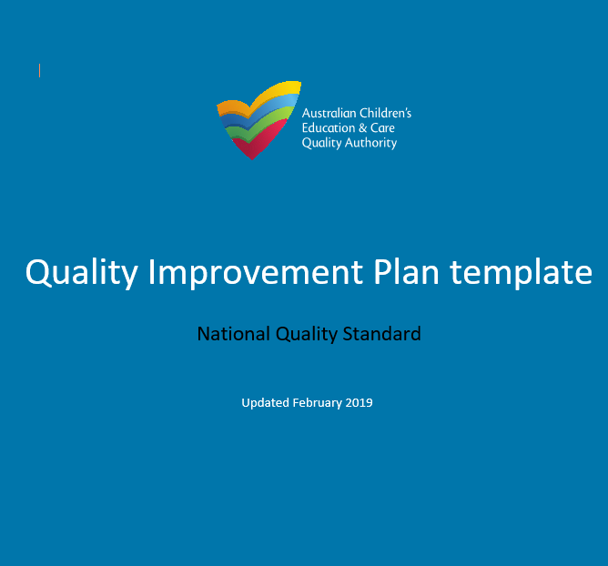
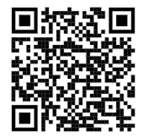
Developing your service’s QIP
When writing the QIP, you should reflect on the outcomes of the self-assessment process.
You may prioritise areas for improvement against the seven quality areas of the NQS and the related regulatory requirements.
There is no need for all 15 standards and 40 elements to be addressed in the QIP. The QIP should include your key areas for improvement.
Your service may have a range of documents to assist with and record the planning process.
The QIP is a summary of the key areas prioritised for improvement.
The QIP does not have to be provided in any specific format.
You can download ACECQA’s optional QIP template from the website using this QR code.
23

Slide 24
Developing your QIP - your service philosophy
Your service’s philosophy helps to guide all of your service’s operations including your continuous improvement strategies.
A statement of philosophy serves three purposes. It:
underpins the decisions, policies and daily practices of your service
reflects a shared understanding of the role of your service among staff, children, families and the community
guides educators in developing an educational program and practice that supports their beliefs and values about children’s learning.
Your philosophy will support your service’s broader vision for quality and quality improvement.
A statement of philosophy is more than a vision statement. Your service philosophy is the ‘why’ behind your work with children, their families and each other.
Your service philosophy should reflect the unique ‘personality’ and context of your service and be a shared vision. It should guide decision-making, policies, daily practices and the program and express a shared understanding of the role of your unique service to educators, children, families and the community.
24

Slide 25
Activity 2
Reflecting on your service philosophy – part 1
Write down or draw three strongly-held beliefs at your service.
Write down or draw what is unique about your service? How is it different to other services?
25

Slide 26
Activity 2
Reflecting on your service philosophy – part 2
Are these strongly-held beliefs visible in your philosophy?
How does your service philosophy and your unique practices provide a clear picture of your service delivery?
26

Slide 27
Developing your QIP - improvement planning
After completing your self-assessment, you can start planning your quality improvements, for any of the seven quality areas.
In your improvement plan you can include:
each standard or element you want to improve upon
the issue identified during self-assessment in relation to that standard or element
what outcome or goal you’re seeking for that particular standard or element
whether the priority for improvement is low, medium or high
what steps you will take to get to the outcome or goal
the ways to measure your success
timeframes - when do you plan on implementing the change?
progress notes – what has already been achieved, what challenges have come up, what details about the improvements you have made have you included?
27

Slide 28
QIP template
Here is an example of what to include in your improvement plan. Remember, you can document your improvement plan in a format that suits you and your service.
Standard or element | Issues identified during self-assessment | What outcome or goal do we want? | Priority: low, medium or high | How will we get this outcome? (steps to take) | Success measure | By when? | Progress notes
28

Slide 29
Developing your QIP – Exceeding NQS themes
As you complete your self-assessment you may identify practice that is exceeding the expectations of the NQS. The Exceeding NQS sections provided in the QIP template and Self-assessment Tool can be completed to identify evidence of one or more of the Exceeding NQS themes impacting on practice at your service.
The Exceeding themes are:
Exceeding theme 1: Practice is embedded in service operations
Exceeding theme 2: Practice is informed by critical reflection
Exceeding theme 3: Practice is shaped by meaningful engagement with families and/or the community.
For more information about the Exceeding themes, go to Section 3 of the Guide to the NQF.
https://www.acecqa.gov.au/nqf/about/guide
29

Slide 30
Activity 3
Reflective questions to consider when writing a QIP
How does your statement of philosophy reflect a commitment to improvement?
How do you collect information from your service community to help your improvement planning cycle?
How do you review your policies and procedures and make improvements to these?
30

Slide 31
Developing your QIP – reflecting and ongoing reviews
Reflect on the goals for your areas of improvement set out in your QIP and begin planning for these improvements.
Documenting and developing strategies will help you implement your plan for improvements. You’ll begin to see better indicators of quality in your service’s practice. Document these improvements and highlight your achievements to share with your service community.
You can make your QIP available to the families and community of your service. Ask for input from them as well as service leaders, educators and children and use their voices in the self-assessment and improvement planning processes. This will help you to paint a vivid picture of your quality service practices and how you are improving outcomes for children.
When you receive feedback about your QIP, either from the regulatory authority or others, review and update your QIP.
Share any feedback you receive with your team and use this feedback to strengthen and improve your service practices.
31

Slide 32
Activity 4
Reflecting on your service QIP
Think about the most recent feedback you have received about your QIP, practices, procedures or environments.
Write down any improvements that need to be made immediately to ensure the health, safety and wellbeing of children?
Write down four or five practices that you feel can be strengths listed in your QIP?
32

Slide 33
Module 3
Bringing it all together: quality improvement
33

Slide 34
Activity 1
What makes your service unique?
Individually or as a team, brainstorm as many things as you can that make you and your service unique. You can write or draw your ideas.
34

Slide 35
Activity 2
Building a positive team culture
Think about your role at the service and how your team works with each other. Write or draw:
How you are involved in building a positive team culture
How is the team already involved in the improvement processes at your service?
How could the team be more involved in the improvement processes at your service?
35

Slide 36
Top tips for creating a positive self-assessment process
1. Appoint a leader
Self-assessment is a collaborative project, but you do need someone to lead and keep it on track.
This might be a great opportunity for someone who may not be in a service leadership role but who has the capability and capacity.
Share the role with others.
2. Be practical
Approach self-assessment with a plan.
Delegate responsibilities of completing tasks with others. Share the load and ask for help.
Approach it in stages - one quality area or standard of the NQS at a time.
3. Keep the process ‘alive’
Self-assessment and quality improvement should be an agenda item at staff meetings. It is not something to be done just once a year.
Display the self-assessment in the staff room. Encourage staff to add to it regularly. Provide post-it-notes next to the display.
4. Engage your community
Invite the service community to participate.
Actively listen to their voices and views of service practices
Include children’s voices in the process.
Create meaningful relationships with your service community members – Quality Area 6 provides more information on how you can do this.
36

Slide 37
Top tips for creating a positive self-assessment process
5. Evidence
Document your self-assessment in a way that suits you and your service community.
Make the information accessible and understandable.
You can write, include photos of positive practice and ask children to draw what they like about their service.
6. Be honest and open
The most effective self-assessment is a true reflection of your service practices and environments.
Reflect honestly and openly on your practice and use this reflection as the launch pad for improvement.
It’s ok to include what you're not doing well, recognising that means you can plan for improvement.
7. Celebrate progress and achievements
Take the time to celebrate your accomplishments and progress with your families, children and service community.
Tell families and the community about the great practices at your service and how they are improving outcomes for the children.
Document these in your self-assessment.
37

Slide 38
Activity 3
Brainstorming self-assessment strategies
At your team meeting brainstorm how you can:
Invite others to join in the self-assessment process.
Share your success and positive practices with families and the service community.
Keep the self-assessment process alive at your service.
38

Slide 39
Activity 4
Quality Improvement Planning
Choose a Quality Area and identify a practice that needs improvement.
* Choose a standard or element. You can then transfer this activity straight into your QIP.
Standard or element | Issues identified during self-assessment | What outcome or goal do we want? | Priority: low, medium or high | How will we get this outcome? (steps to take) | Success measure | By when? | Progress notes
39

Slide 40
Top tips for maintaining your QIP
1. Keep the QIP ‘active’
Your service’s QIP is a dynamic and evolving document and continuous engagement with your service’s community will keep it active. Make your QIP visible, accessible and invite people to engage with it. You could try:
putting it on a notice board in the foyer
putting parts of it in your newsletter
provide post-it notes for people to provide input and feedback
ask for input and then use the feedback you receive.
Documentation provides evidence of your planning and could be paper-based, electronic or pictorial. If you have a post-it note wall of comments –a photo is an easy way to capture this information.
Embedding quality improvement in staff, family or community meetings as an agenda item will also keep it front of mind.
2. Prioritise your work
Try not to achieve everything at once. Break up the National Quality Standard into quality areas or standards and share the work on them, piece by piece.
If you identify a number of improvements, choose which ones should be a priority and which ones can be improved over time. What are the high versus low, or even medium priorities?
40

Slide 41
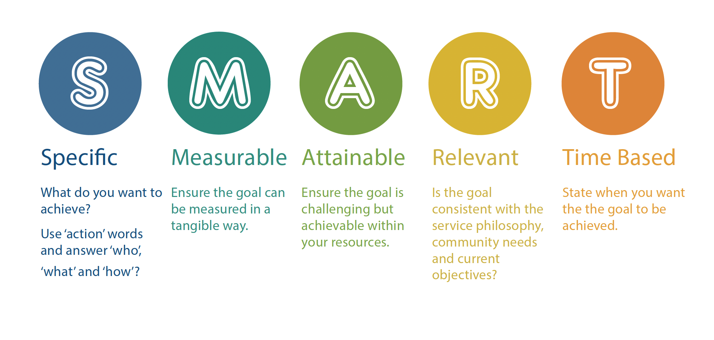
Top tips for maintaining your QIP
3. Use the SMART approach to develop goals for your QIP.
41

Slide 42
Top tips for maintaining your QIP
4. Update progress notes and celebrate achievements.
Documenting progress towards your goals will keep you on track and also provide opportunities to celebrate important milestones in the journey to your goals
Decide who will be responsible for updating progress notes in your QIP
Decide how often progress notes will be updated
Share your successful improvements with your service community – include it in a newsletter, display photos in your foyer, send it via email or invite the community into your service for a special celebratory morning tea.
5. Use feedback from authorised officers
When you receive feedback from an authorised officer, it’s helpful to refer to your QIP and the improvements your working towards.
Consider if there is anything that needs changing in your improvement plan, is there an opportunity for you to include their feedback into any of the existing improvement plans?
Feedback can be useful to guide your living QIP to move forward.
Use any feedback you have received about your service to guide your continuous quality improvement planning.
42

Slide 43

Activity 5
My reflections on my practice
What am I doing well?
What do I want to learn more about in the next 12 months?
What do I enjoy about my role?
What
has challenged me over the last 12 months?
What practices need improving?
What service practices am I proud of and could share with families?
43

Slide 44

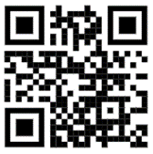
ACECQA Website
www.acecqa.gov.au
44

Slide 45
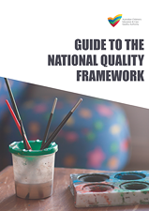
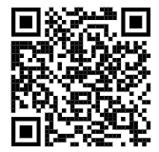
Guide to the National Quality Framework
The Guide to the National Quality Framework has useful information on self-assessment and developing a QIP.
https://www.acecqa.gov.au/sites/default/files/2018-11/Guide-to-the-NQF_0.pdf
45

Slide 46

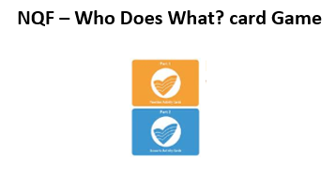
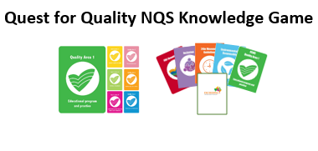
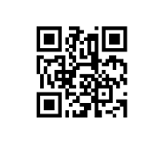
ACECQA educational games to support ongoing learning
https://www.acecqa.gov.au/resources/supporting-materials/games
46

Slide 47
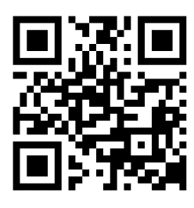
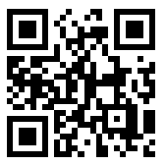
ACECQA Contacts and subscriptions to support ongoing learning
ACECQA
Website: www.acecqa.gov.au
Email: info@acecqa.gov.au
Facebook: www.facebook.com/ACECQA
Phone: 1300 422 327
Subscribe to:
ACECQA Newsletter
‘We Hear You’ & NEL Blog
47

Slide 48
Notes
Follow up actions
48

